Slide 1
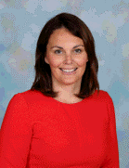
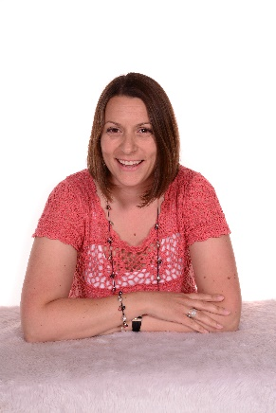
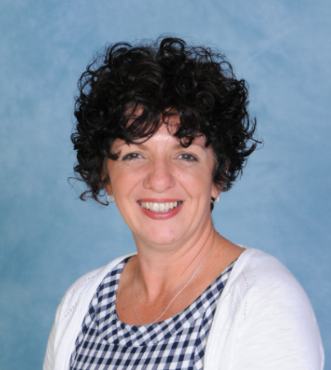
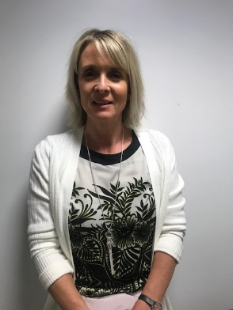
Welcome To Year 1

Slide 2
Come and see us!
Goldfinches – Mrs Weaver, Mrs Darch
Mrs McDevitt, Mrs Lo
Owls – Mrs Goodey/Mrs Twyman
Miss James
You are welcome to see us before 8.40am, after 3.00pm or make an appointment.

Slide 3
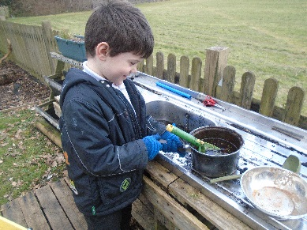
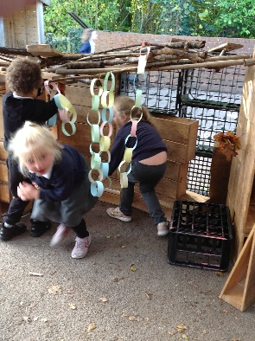
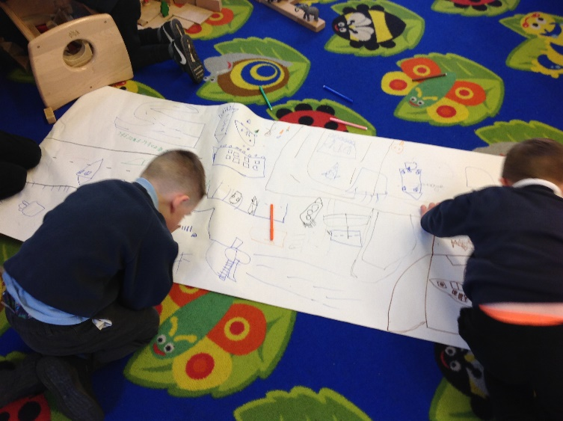
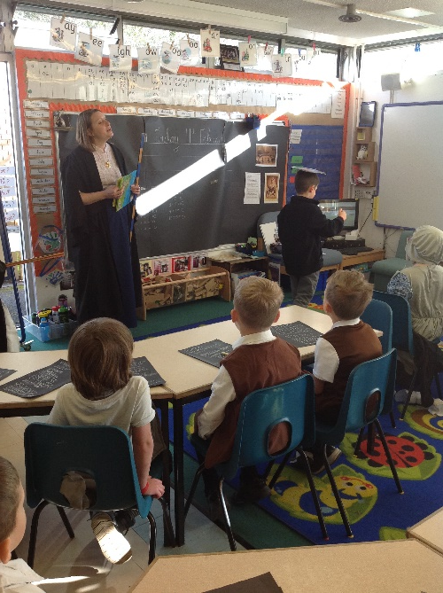
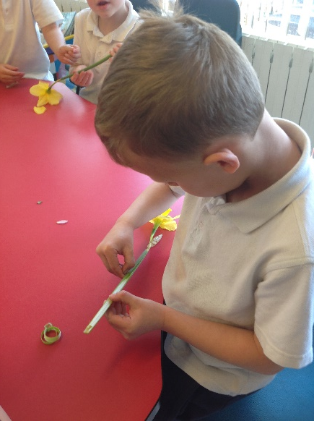
Expectations
The move from Early Years Curriculum to Key Stage One.
Learning is more structured but still very much child led.
Phonics screening in June where all Year 1 children will be assessed.
Notes:
Ready for their next step in their learning journey- tired
Small group work
Children have the opportunity to access outside learning, small world activities as well as sand, water and construction which are linked to the learning they are doing in class.

Slide 4
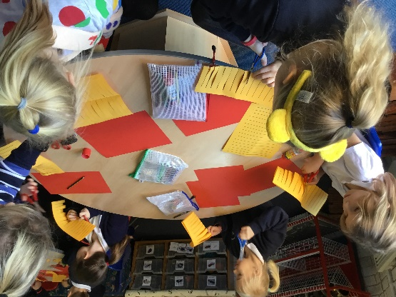
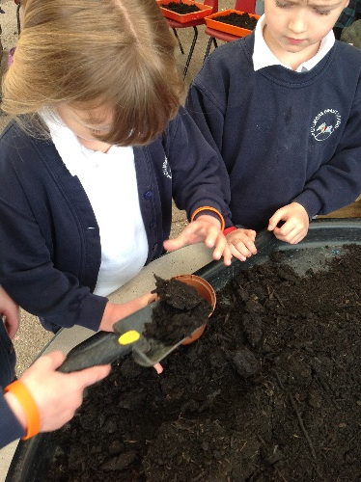
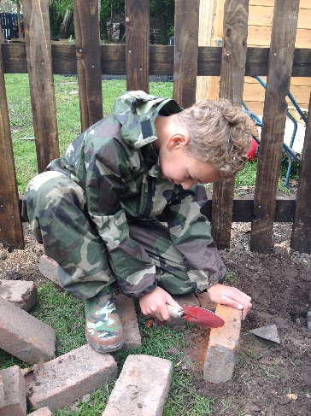
A Typical Day in Year 1
8:40 Greet children / register
8:55 RWI
9:35 Literacy and handwriting
10:30 Assembly
10:45 Playtime
11:00 Maths
12:00 Lunch
1:00 Afternoon phonics
1:30 Science/Geography/History
Art /DT /PE/ music/ RE
2:45 Story time
3: 00 Home time
Key dates
Thursday - library book change (leave book in book bag all the time)
Monday & Friday- PE

Slide 5
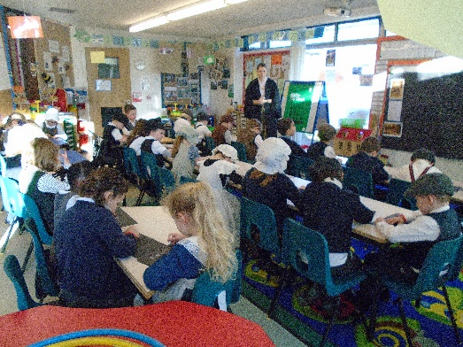
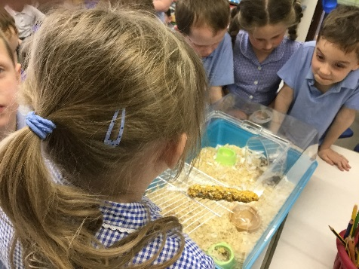
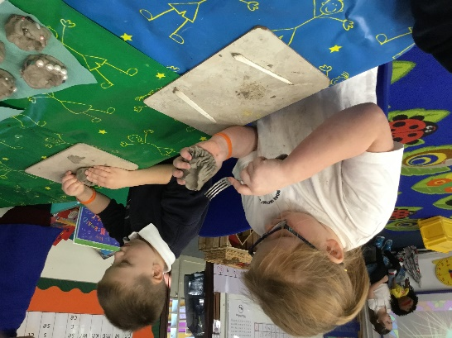
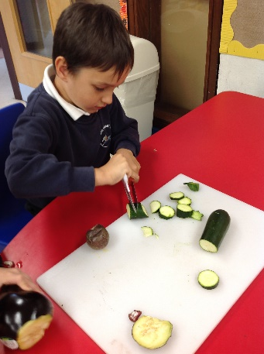
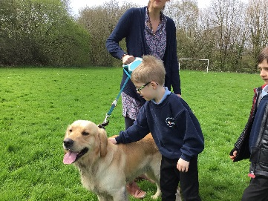
Topics for the year
Autumn Term
Food Glorious Food– keeping fit & healthy eating and Harvest.
All About Calmore – Calmore the local area, reading and
making maps, Christmas
Spring Term
Queens – Through time – Learning about Queen Elizabeth 1, 11 and Queen Victoria
Florence and Mary Seacole – learning about the impact Florence and
Mary had on our lives
Summer Term
Awesome Animals – Animals and mini-beasts
Wonderful Weather – Looking at the weather including extreme weather
in the UK and in different countries

Slide 6
Home - school learning
Books:
RWI reading book– once a week, your child will share the book they have been reading in their phonic group. In addition they will bring home a book bag book related to the text they have been reading in phonics.
Library Book– Please share the book your child has chosen.
Library day: Thursday every week (but ensure it is in your child’s book bag daily)

Slide 7
UNIFORM
PE kits to be worn on a Monday and Friday
Wellies and water suit
Make sure your child has a named coat in school.
Please ensure your child has a Book Bag in school everyday.

Slide 8
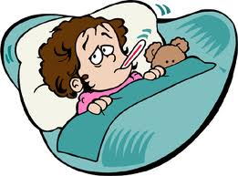
Reminders!
If your child is ill…..phone/email the school on the first day of absence
Let us know if someone else is collecting your child – in the diary at the office
Phonics screening - June
Notes:
at the end of Year 1 every child will undertake a phonics screening, there will be a meeting nearer the time to discuss what will happen here.

Slide 9
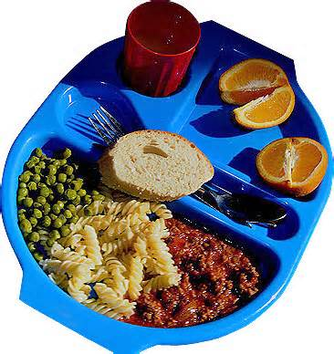
Milk-no longer free
Fruit-free
Lunches-free

Slide 10
A little plea for help...
Could you possibly spare a little bit of time during the week?
Are you DBS checked? Could you come on trips with us?
If you can please speak to Kelly or us!

